Slide 1
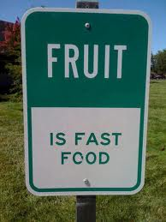
Fruit notes

Slide 2
Notes
A vitamin is a nutrient essential for growth and normal functioning of the body
Ascorbic acid is the chemical name for vitamin C
Scurvy is a disease that is caused by a lack of vitamin C

Slide 3
Carotene is a yellow to orange plant pigment that can be converted to vitamin C by the body.
An enzyme is a substance which causes a chemical reaction to take place.

Slide 4
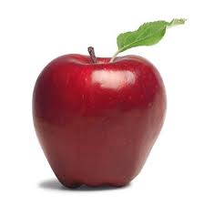
Pomes
Pomes are characterized by a smooth skin covering an enlarged fleshy area surrounding the core. Examples include:
Apple

Slide 5
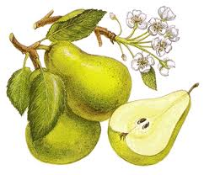
Pomes
Pear

Slide 6
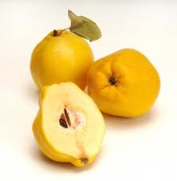
Pomes
Quince

Slide 7
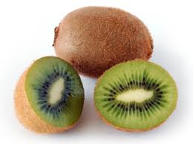
Pomes
Kiwi

Slide 8
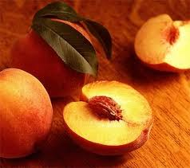
Drupes
Drupes contain a single seed surrounded by fleshy, juicy edible portion. Fruits that are classified as drupes are:
Peaches

Slide 9
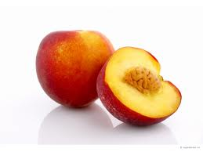
Drupes
Nectarines. Similar to peaches, but a smooth skin.

Slide 10
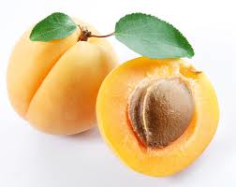
Drupes
Apricots

Slide 11
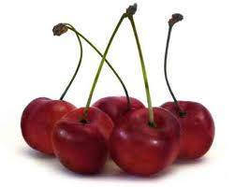
Drupes
Cherries

Slide 12
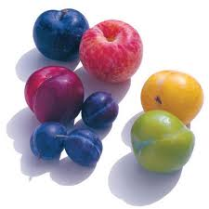
Drupes
Plums

Slide 13
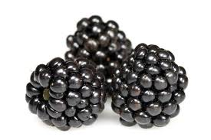
Berries
Berries have tiny seeds imbedded in the flesh and a fragile cell structure.
The best known berries are:
Blackberries

Slide 14
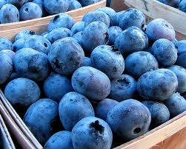
Berries
Blueberries

Slide 15
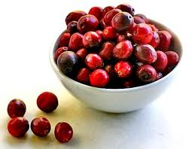
Berries
Cranberries

Slide 16
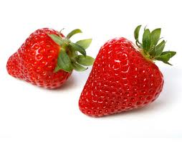
Berries
Strawberries

Slide 17
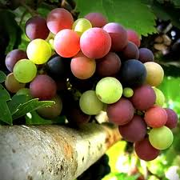
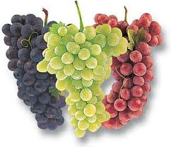
Berries
Grapes are also classified as berries. They have fairly tough skins and grow in bunches. They range in colour from green to red and purple.

Slide 18
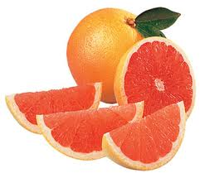
Citrus
Citrus fruits include grapefruit.

Slide 19
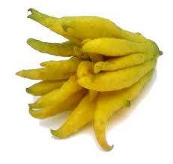
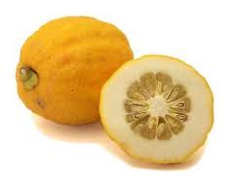
Citrus
Citron. (Not often eaten raw, but often candied)
Buddah Hand citron

Slide 20
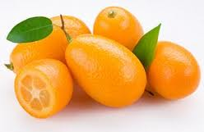
Citrus
Kumquat

Slide 21
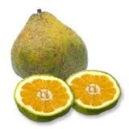
Citrus Fruit
Ugli

Slide 22
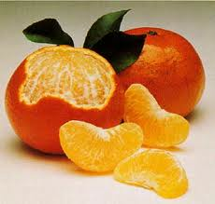
Citrus
Tangerine

Slide 23
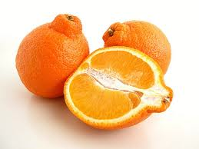
Citrus
Tangelo: cross between a tangerine, orange and grapefruit.

Slide 24
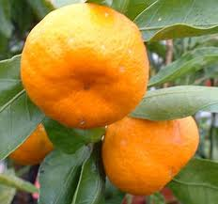
Citrus
Mandarin. Which has loose skin and easily separated segments

Slide 25
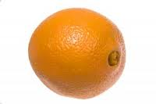
Citrus
Navel orange.

Slide 26
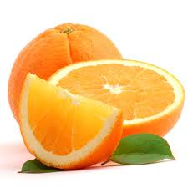
Citrus
Valencia

Slide 27
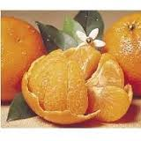
Citrus
Temple

Slide 28
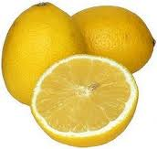
Citrus
Lemon

Slide 29
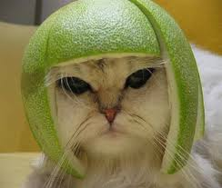
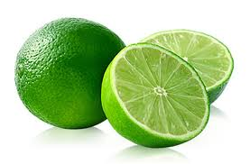
Citrus
Lime

Slide 30
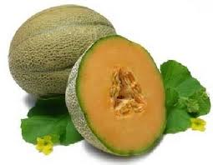
Melons
Some varieties of melons:
Muskmelon

Slide 31
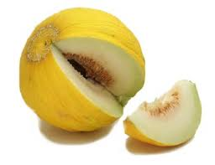
Melon
Casaba

Slide 32
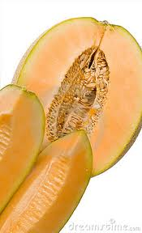
Melons
Persian

Slide 33
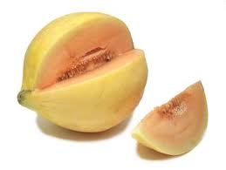
Melons
Cranshaw

Slide 34
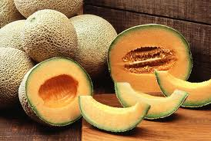
Melon
Cantaloupe

Slide 35
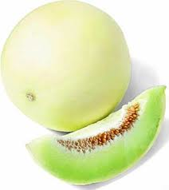
Melon
Honeydew

Slide 36
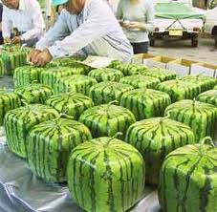
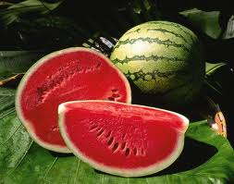
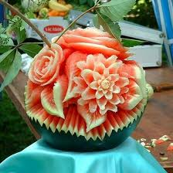
Melon
Watermelon

Slide 37
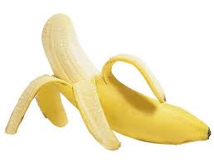
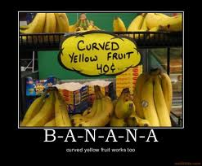
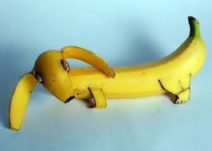
Tropical fruits
Banana

Slide 38
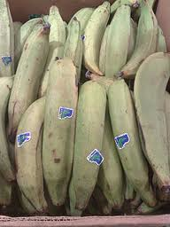
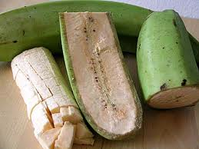
Tropical Fruit
Plantain

Slide 39
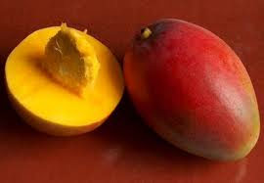
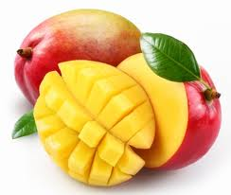
Tropical Fruit
Mango

Slide 40
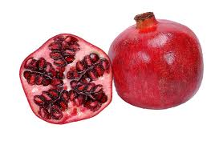
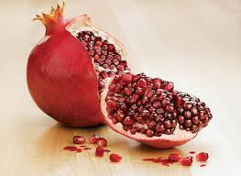
Tropical Fruit
Pomegranate

Slide 41
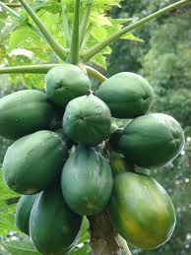
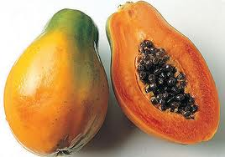
Tropical Fruit
Papaya

Slide 42
Tropical Fruit
Avocado

Slide 43
Tropical Fruit
Pineapple

Slide 44
Tropical Fruits
Date

Slide 45
Tropical Fruit
Fig

Slide 46
Dragon Fruit

Slide 47
Passion Fruit

Slide 48
Spiky Kiwano Melon

Slide 49
Star Fruit

Slide 50
Prickly Pear

Slide 51
Lychee

Slide 52
Durian

Slide 53
Mangostien

Slide 54
Fruit
Many fruits are available in several forms:
Fresh
Frozen
Canned
Dried

Slide 55
Buying Fruit
When buying fresh fruit, you should usually select only ripe fruit. Softening fruit can be slowed down by proper refrigeration. Large fruits are generally more expensive than others, and often have flavour and texture that are less desirable than those of similar fruits. Usually fresh fruits grown locally are lowest in price.

Slide 56
Frozen Fruit
Fruits to be frozen are usually sweetened and then frozen quickly; they are much like fresh fruits. During canning, fruits are exposed to high temperature to prevent spoilage. Dried fruits include plums (prunes), apricots, dates, figs, grapes (raisins), currants, and mixed fruits. During drying, most of the water is removed.

Slide 57
Purchasing Fruit
When purchasing fruit, it is important to consider the intended use. Popular eating apple because of their flavour are red or yellow delicious, while Rome Beauty and McIntosh have excellent cooking qualities

Slide 58
Grading Fruit
Grades for fresh fruit have been established by the USDA. The premium grades are US extra fancy , US Fancy, and US #1, while basic trading grades are US #1 and US #2.

Slide 59
Fruit Prices
Fruit prices are not a reliable guide to quality and nutritive value. Generally, those in season cost less. Good quality fruits are sound (free from blemishes, mold, etc.) crisp (not wilted or limp), and firm (not overripe or soft).

Slide 60
Selecting Fruit
When selecting frozen fruits, you must often rely on the brand name. Avoid buying packages that are stained or not hard frozen.
Dried fruit come in protective cartons or in clear bags. Information about the contents is on a label.

Slide 61
Fruit Storage
Most fruits are stored in the refrigerator; those with strong aromas should be wrapped first. Frozen fruits should not be thawed until ready for use and should never be refrozen. Canned foods should be stored in a cool, dry place before opening, and in the refrigerator after opening. Cooked dried fruits should be covered and refrigerated.

Slide 62
Nutrients
The nutrients are divided into six groups
Carbohydrates
Fats
Proteins
Vitamins
Minerals
Water

Slide 63
Nutrients
Fruits are the best sources of vitamin C
They also contain vitamins A and B
The fruits that provide the most vitamin C belong to the citrus group.
Your body does not store vitamin C, so you should eat a food high in vitamin each day.

Slide 64
Nutrients
The minerals calcium and iron are found in fruits in important amounts, along with carbohydrates sugar and cellulose.

Slide 65
Raw Fruits
Raw fruits need only a thorough washing before eating. Discolouration of low acid fruits can be prevented by sprinkling the cut surface with acid fruit juice.

Slide 66
Fruit Cookery
The two principles involved in fruit cookery are:
A change in texture , form or consistency of fruit
The preservation of nutrients

Slide 67
Fruit Cookery
When fruits are cooked in moist heat the cellulose becomes soft and the fruit breaks apart.
If you want the fruit to retain its shape, you should add sugar to the cooking water.

Slide 68
Preserving Nutrients
To preserve nutrients in fruits, do not expose them to oxygen (in the air) for long periods of time and cook them in as little water as possible. You will also retain more nutrients when fruits are used with their skins.

Slide 69
Fruit Cookery
Fruits are most often cooked by simmering, stewing and baking.
To simmer, fruits are cooked in their own juices or a small amount of water. They are often mashed to give uniform consistency.
Stewed fruit is usually cooked in liquid with sugar to retain the shape.
Fruits with heavy skins are good for baking.

Slide 70
Fruit Cookery
Dried fruits should be cooked at a simmering temperature in a covered pan.
When sugar is used, it is added at the end.
Fruits may be made into fritters by dipping them in a batter and deep-frying them.
Fruits are often used in baked products such as quick breads and pies.
Fruit-flavoured sherberts and ice creams are always popular.

Slide 71
Fruit Preservation
Canned, frozen and dried fruits offer a convenience, by preventing spoilage and eliminating preparation procedures.
Convenience items have been designed to help people use less time, effort and energy in meal preparation. However, because of the wide variety, decision making has become more complicated.

