Slide 1
Vegetables
Notes

Slide 2
Vegetables are categorized in three ways:
Colour
Flavour
Part of the plant eaten

Slide 3
Colour Classification:
Green
Red/Purple
Orange/Yellow
White

Slide 4
Flavour Classification
Strong
Mild
Peppers
Onions
Garlic
Peas
Beans
Corn

Slide 5
Part of Plant Eaten:
Flower
Stem
Leaf
Fruit
Root
Seeds
Tuber
Bulb

Slide 6
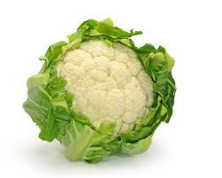
Flower
These vegetables tend to hold a lot of water and are rich in antioxidants (foods that help remove harmful substances in the body)
Cauliflower

Slide 7
Broccoli

Slide 8
Purple Broccoli

Slide 9
Romanesque Broccoli
Roman Cauliflower

Slide 10
Broccoflower

Slide 11
Artichoke

Slide 12
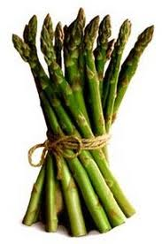
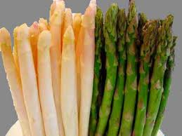
Stem (or Shoot)
Good source of vitamins and water
Asparagus (white or green)

Slide 13
Celery

Slide 14
Fiddlehead Ferns

Slide 15
Fennel

Slide 16
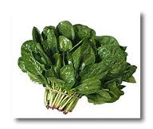
Leaf
Contains chlorophyll which gives them a green colour, usually high in iron and vitamin A.
Spinach

Slide 17
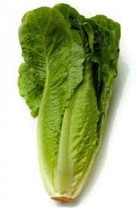
Iceberg Lettuce
Romaine Lettuce

Slide 18
Endive

Slide 19
Red and Green Cabbage

Slide 20
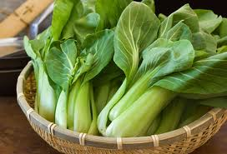
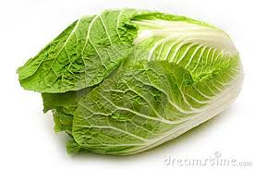
Radicchio
Bok Choy
Chinese Cabbage

Slide 21
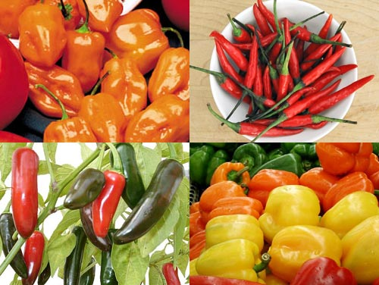
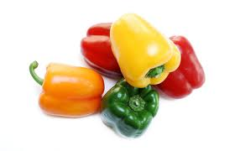
Fruit
Good source of a variety of vitamins and minerals
Anything that encases the seed of the plant can be called the fruit.
Bell Peppers
Chili Peppers

Slide 22
Tomatoes

Slide 23
Tomatillo
Tomatillos are also referred to as husk tomatoes, jamberries, strawberry tomatoes and Mexican green tomatoes.

Slide 24
Okra

Slide 25
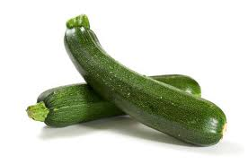
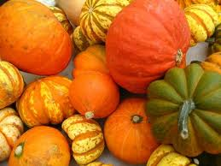
Zucchini
Squash
Cucumber

Slide 26
Root
Good sources of minerals.
They are very hearty and often can be stored for long periods of time.

Slide 29
Seeds

Slide 30
Tuber
Tubers are a storage vegetable often containing energy in the form of carbohydrates.

Slide 32
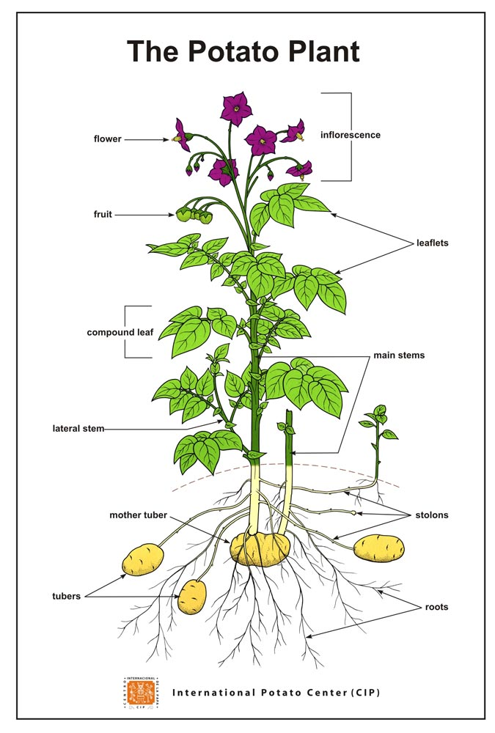

Slide 33
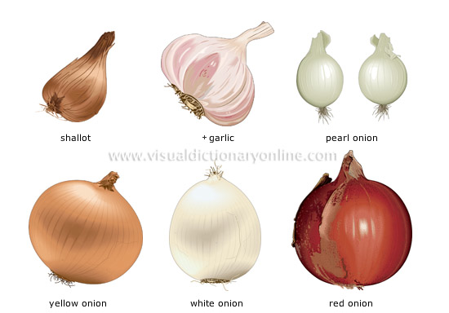
Bulb
Often strong flavours, used for storage energy and a good source of minerals.

Slide 35
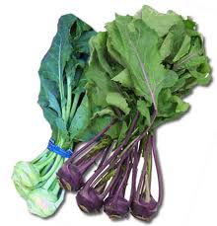
Kolhrabi

Slide 36
Cooking Principles
Vegetables have a variety of minerals and nutrients and cooking can actually cause the nutrients to leave the vegetable. To prevent this from happening cook them correctly
Steam – don’t let the water touch the vegetables
Boil – use only enough water tocover vegetables.
Use a lid for mild flavoured vegetables
Cook only until TENDER-CRISP
Have as little surface area as possible exposed

